Slide 1
B.Tech Project Presentation · 2025-26
IDEATE AND IMPLEMENT A SYSTEM TO ENHANCE THE QUALITY OF EDUCATION IN RURAL AREAS
MERN-based intelligent learning platform with AI-driven tutoring, multilingual support,
and adaptive learning modules tailored for rural communities.
Himanshu Dwivedi (2200290120080) | Mukul Mittal (2200290120105) Dipendra P. Singh (2200290120067) | Mohd Asad (2200290120103)
Guide: Dr. Raj Kumar (Associate Professor & Program Head) KIET Group of Institutions, Ghaziabad

Slide 2
Why Rural Education Needs Intervention
Poor Connectivity
Slow, unreliable network connections prevent consistent access to digital learning resources.
Lack of Teachers
Rural schools face chronic shortage of trained educators, leading to poor academic foundations.
Limited Device Access
Multiple students share a single smartphone in most rural households.
Language Barriers
Most digital platforms operate only in English, alienating regional language students.
Poor Infrastructure
Inadequate buildings, no electricity, and absence of digital labs.
Widening Digital Divide
The gap between urban and rural students continues to grow.

Slide 3
What We Aim to Achieve
1. Build a lightweight MERN platform for settings with limited internet connectivity.
2. Incorporate AI-driven support for immediate doubt clarification and tutoring.
3. Introduce multilingual assistance and voice-activated navigation tools.
4. Facilitate real-time teacher-student interaction through WebRTC.
5. Create adaptive learning modules based on individual student progress.
6. Guarantee data security with JWT and role-based access control.
7. Present comprehensive analytics dashboards for instructors and parents.
8. Develop a cost-effective, scalable system that narrows the digital divide.

Slide 4
Modular System Architecture
RBAC Auth
Secure OTP-based registration for all roles.
AI Learning
AI tutoring resolves doubts and provides feedback.
CMS
Teachers upload organized materials & quizzes.
Analytics
Tracks attendance and performance data.
Multilingual
Multiple regional languages for accessibility.
Secure Cloud
Centralized DB with end-to-end encryption.
Parent Module
Access to monitor performance & attendance.
Scalability
Flexible deployment across schools/villages.

Slide 5
MERN Full-Stack Integration
MongoDB
NoSQL database for profiles and analytics.
Express.js
Robust REST APIs for content delivery.
React.js
Lightweight UI for low-end smartphones.
Node.js
Runtime for real-time data exchange.
AI / NLP
Doubt resolution tutoring.
WebRTC
Real-time doubt sessions.
AWS Cloud
Secure and scalable hosting.
JWT Security
Secure role-based access.

Slide 6
Data Flow & Use Cases
DFD (Level 1) Overview
The system processes inputs from Students, Teachers, and Admins through a central processing core. [ Actors ] → [ Process 1.0 ] → [ MongoDB ] (Output: Content, Analytics, AI Responses)
Actor Roles
STUDENT: Take Quiz, View Content, AI Chat.
TEACHER: Upload Content, Create Quiz, Resolve Doubts.
PARENT: View Progress, Attendance Reports.
ADMIN: Manage Users, Config, System Analytics.

Slide 7
Comprehensive Testing Summary
ID | Description | Expected Result | Status
TC-01 | User registration with OTP | Account created, role assigned | PASS
TC-02 | AI chatbot doubt resolution | Contextual response < 2s | PASS
TC-03 | Quiz auto-evaluation | Score calculated, stored in DB | PASS
TC-04 | WebRTC session stability | Audio connects at 256kbps | PASS
TC-05 | Role-based access control | Unauthorized access blocked | PASS

Slide 8
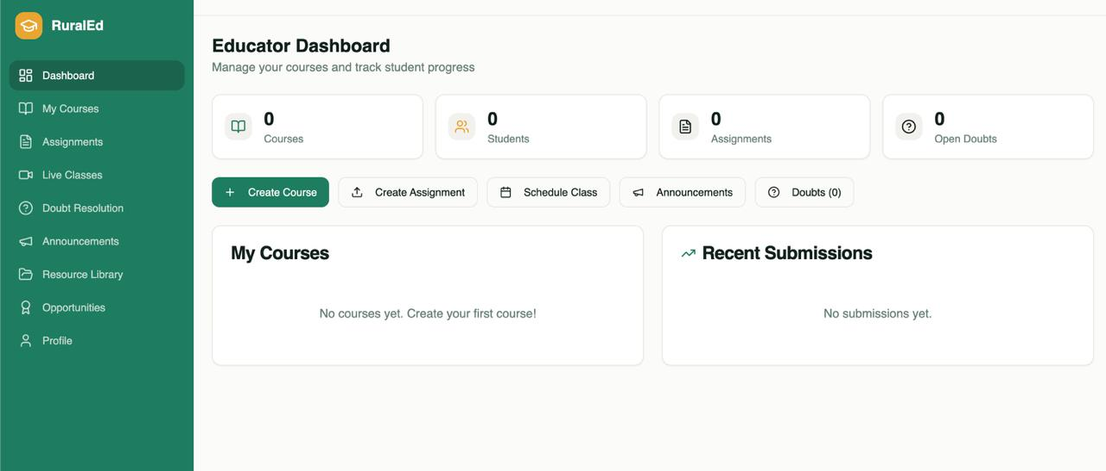
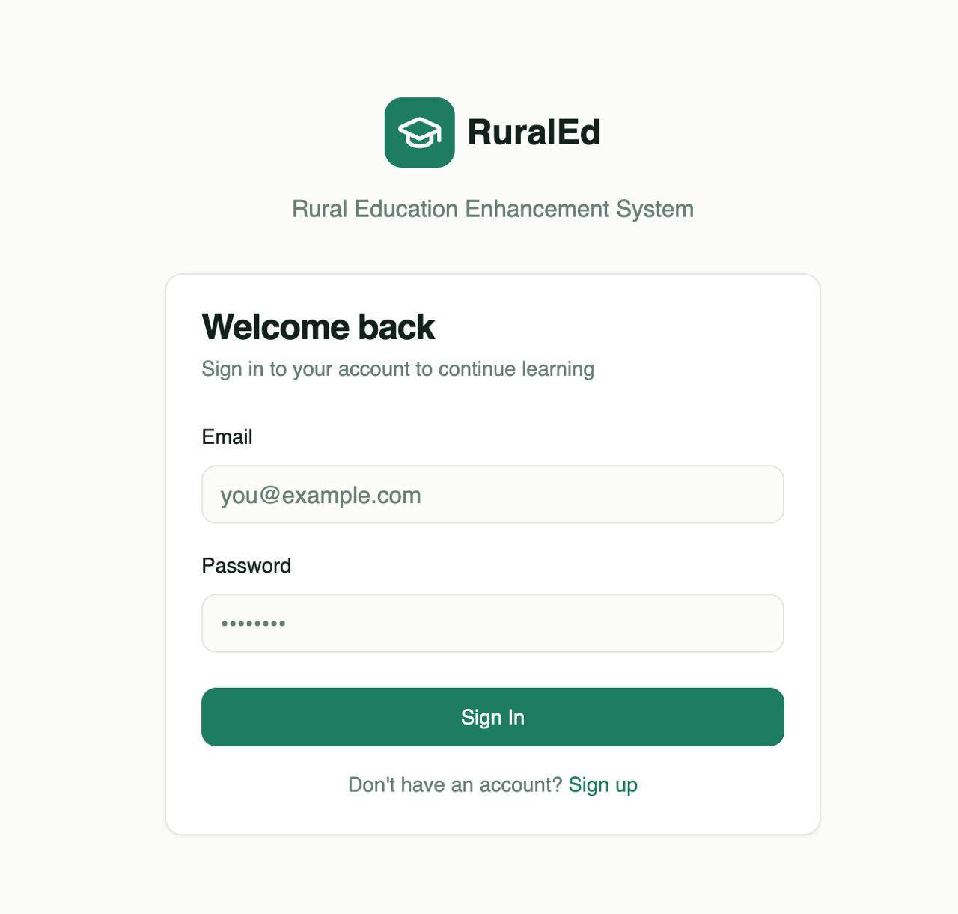
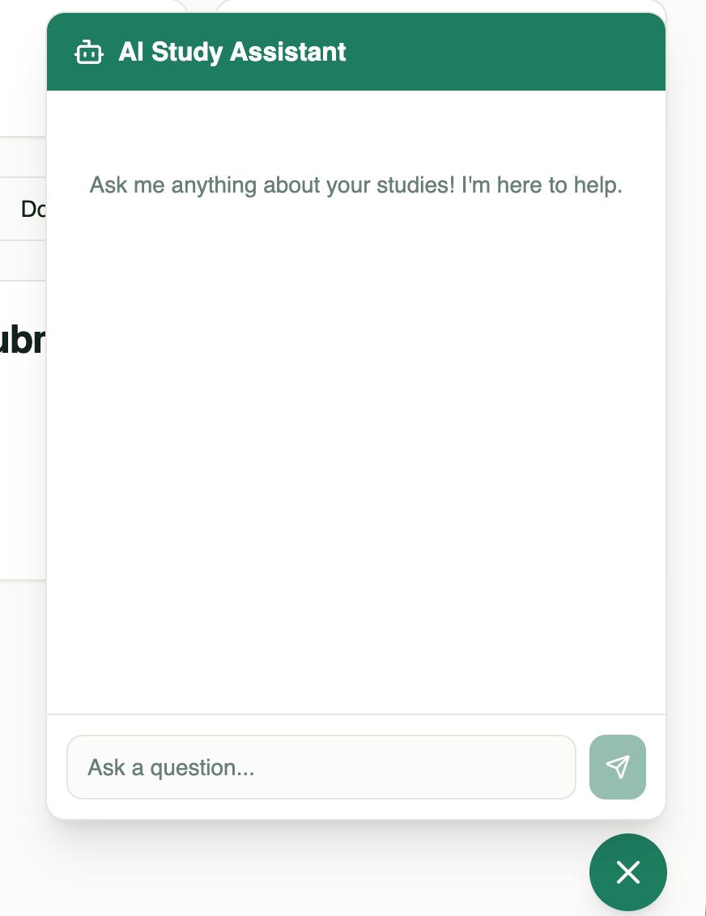
Results & Module Interfaces
Educator Dashboard
Unified management of courses, tracking, and open doubts.
Secure Sign In
Robust authentication for multi-role user access.
AI Study Assistant
NLP chatbot providing instant academic guidance.

Slide 9
Sustainable Development Goals
SDG 4: Quality Education
• Addresses gap through MERN stack + AI tools. • Provides accessible, interactive learning. • Overcomes poor infrastructure challenges.
SDG 16: Strong Institutions
• Accountable service delivery through transparency. • AI-chatbot simplifies info access. • Responsive and inclusive platform.

Slide 10
Summary & Future Scope
Project Summary
The system bridges the digital divide with AI-driven tutoring and low-bandwidth WebRTC support, successfully providing inclusive educational ecosystems.
Future Scope
→ Enhanced AI Personalization & ML models.
→ Extended regional curriculum integration.
→ Native Mobile Apps (Android/iOS).
Thank You — Questions?

